Slide 1
Inspect, ISP, and FIB
Tools for Dynamic Verification and Analysis of Concurrent Programs
Faculty
Ganesh Gopalakrishnan and Robert M. Kirby
Students
Inspect : Yu Yang, Xiaofang Chen
ISP : Sarvani Vakkalanka, Anh Vo, Michael DeLisi
FIB : Subodh Sharma, Sarvank Vakkalanka
School of Computing, University of Utah, Salt Lake City
Supported by
Microsoft HPC Institutes,
NSF CNS-0509379
Acknowledgements:
Rajeev Thakur (Argonne) and Bill Gropp (UIUC)
for ideas and encouragement
http://www.cs.utah.edu/~ganesh links to our research page

Slide 2
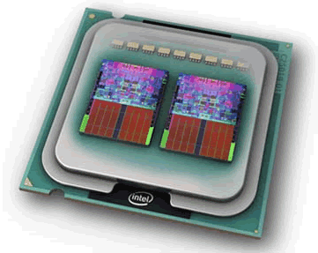
Multicores are the future!
Need to employ / teach concurrent programming at an unprecedented scale!
Some of today’s proposals:
Threads (various)
Message Passing (various)
Transactional Memory (various)
OpenMP
MPI
Intel’s Ct
Microsoft’s Parallel Fx
Cilk Arts’s Cilk
Intel’s TBB
Nvidia’s Cuda
…
(photo courtesy of Intel Corporation.)
Notes:
A caching hierarchy can be designed either as inclusive, exclusive, and non-inclusive. Referring to our 2-level protocol, “inclusive” means the content of the L1 cache is a subset of the L2 cache. “Exclusive” means that any block that is present in an L1 cache, it cannot be present in the L2 cache in the same cluster. And “non-inclusive” lies between inclusive and exclusive.
In fact, we can take inclusive and exclusive as special cases of non-inclusive protocols. So it can be said that if we can effectively verify non-inclusive protocols, we can actually verify the protocol with any caching policy.

Slide 3
Goal: Address Current Programming Realities
Code written using mature libraries
(MPI, OpenMP, PThreads, …)
Model building
and
Model maintenance
have HUGE costs
(I would assert:
“impossible in
practice”)
and does not
ensure confidence !!
API calls made from real programming languages
(C, Fortran, C++)
Runtime semantics determined by realistic Compilers and Runtimes

Slide 4
While model-based verification often works, it’s often not going to be practical: Who will build / maintain these models?
proctype fork(chan lp, rp)
{ do
:: rp?are_you_free
->
rp?release
:: lp?are_you_free
->
lp?release
od
}
init {
chan c0 = [0] of { mtype }; chan c1 = [0] of { mtype };
chan c2 = [0] of { mtype }; chan c3 = [0] of { mtype };
chan c4 = [0] of { mtype }; chan c5 = [0] of { mtype };
atomic {
run phil(c0, c5, 0); run fork(c0, c1);
run phil(c1, c2, 1); run fork(c2, c3);
run phil(c3, c4, 2); run fork(c4, c5); }
}
/* 3 philosophers – symmetry-
breaking to avoid deadlocks */
mtype = {are_you_free, release}
bit progress;
proctype phil(chan lf, rf; int philno)
{ do
:: lf!are_you_free
->
rf!are_you_free
->
begin eating
->
end eating
->
lf!release
->
rf!release
od
}
Notes:
A caching hierarchy can be designed either as inclusive, exclusive, and non-inclusive. Referring to our 2-level protocol, “inclusive” means the content of the L1 cache is a subset of the L2 cache. “Exclusive” means that any block that is present in an L1 cache, it cannot be present in the L2 cache in the same cluster. And “non-inclusive” lies between inclusive and exclusive.
In fact, we can take inclusive and exclusive as special cases of non-inclusive protocols. So it can be said that if we can effectively verify non-inclusive protocols, we can actually verify the protocol with any caching policy.

Slide 5
proctype fork(chan lp, rp)
{ do
:: rp?are_you_free
->
rp?release
:: lp?are_you_free
->
lp?release
od
}
init {
chan c0 = [0] of { mtype }; chan c1 = [0] of { mtype };
chan c2 = [0] of { mtype }; chan c3 = [0] of { mtype };
chan c4 = [0] of { mtype }; chan c5 = [0] of { mtype };
atomic {
run phil(c5, c0, 0); run fork(c0, c1);
run phil(c1, c2, 1); run fork(c2, c3);
run phil(c3, c4, 2); run fork(c4, c5); }
}
/* 3 philosophers – symmetry-
breaking forgotten! */
mtype = {are_you_free, release}
bit progress;
proctype phil(chan lf, rf; int philno)
{ do
:: lf!are_you_free
->
rf!are_you_free
->
begin eating
->
end eating
->
lf!release
->
rf!release
od
}
Notes:
A caching hierarchy can be designed either as inclusive, exclusive, and non-inclusive. Referring to our 2-level protocol, “inclusive” means the content of the L1 cache is a subset of the L2 cache. “Exclusive” means that any block that is present in an L1 cache, it cannot be present in the L2 cache in the same cluster. And “non-inclusive” lies between inclusive and exclusive.
In fact, we can take inclusive and exclusive as special cases of non-inclusive protocols. So it can be said that if we can effectively verify non-inclusive protocols, we can actually verify the protocol with any caching policy.

Slide 6
/* 3 philosophers – symmetry-
breaking forgotten! */
mtype = {are_you_free, release}
bit progress;
proctype phil(chan lf, rf; int philno)
{ do
:: lf!are_you_free
->
rf!are_you_free
->
begin eating
->
end eating
->
lf!release
->
rf!release
od
}
Notes:
A caching hierarchy can be designed either as inclusive, exclusive, and non-inclusive. Referring to our 2-level protocol, “inclusive” means the content of the L1 cache is a subset of the L2 cache. “Exclusive” means that any block that is present in an L1 cache, it cannot be present in the L2 cache in the same cluster. And “non-inclusive” lies between inclusive and exclusive.
In fact, we can take inclusive and exclusive as special cases of non-inclusive protocols. So it can be said that if we can effectively verify non-inclusive protocols, we can actually verify the protocol with any caching policy.

Slide 7
Instead, model-check this directly!
permits[i%NUM_THREADS] = 0;
printf("P%d : get F%d\n", i, i%NUM_THREADS);
pthread_mutex_unlock(&mutexes[i%NUM_THREADS]);
// pickup right fork
pthread_mutex_lock(&mutexes[(i+1)%NUM_THREADS]);
while (permits[(i+1)%NUM_THREADS] == 0) {
printf("P%d : tryget F%d\n", i, (i+1)%NUM_THREADS);
pthread_cond_wait(&conditionVars[(i+1)%NUM_THREADS],&mutexes[(i+1)%NUM_THREADS]);
}
permits[(i+1)%NUM_THREADS] = 0;
printf("P%d : get F%d\n", i, (i+1)%NUM_THREADS);
pthread_mutex_unlock(&mutexes[(i+1)%NUM_THREADS]);
//printf("philosopher %d thinks \n",i);
printf("%d\n", i);
// data = 10 * data + i;
fflush(stdout);
// putdown right fork
pthread_mutex_lock(&mutexes[(i+1)%NUM_THREADS]);
permits[(i+1)%NUM_THREADS] = 1;
printf("P%d : put F%d\n", i, (i+1)%NUM_THREADS);
pthread_cond_signal(&conditionVars[(i+1)%NUM_THREADS]);
pthread_mutex_unlock(&mutexes[(i+1)%NUM_THREADS]);
#include <stdlib.h> // Dining Philosophers with no deadlock
#include <pthread.h> // all phils but "odd" one pickup their
#include <stdio.h> // left fork first; odd phil picks
#include <string.h> // up right fork first
#include <malloc.h>
#include <errno.h>
#include <sys/types.h>
#include <assert.h>
#define NUM_THREADS 3
pthread_mutex_t mutexes[NUM_THREADS];
pthread_cond_t conditionVars[NUM_THREADS];
int permits[NUM_THREADS];
pthread_t tids[NUM_THREADS];
int data = 0;
void * Philosopher(void * arg){
int i;
i = (int)arg;
// pickup left fork
pthread_mutex_lock(&mutexes[i%NUM_THREADS]);
while (permits[i%NUM_THREADS] == 0) {
printf("P%d : tryget F%d\n", i, i%NUM_THREADS);
pthread_cond_wait(&conditionVars[i%NUM_THREADS],&mutexes[i%NUM_THREADS]);
}
Notes:
A caching hierarchy can be designed either as inclusive, exclusive, and non-inclusive. Referring to our 2-level protocol, “inclusive” means the content of the L1 cache is a subset of the L2 cache. “Exclusive” means that any block that is present in an L1 cache, it cannot be present in the L2 cache in the same cluster. And “non-inclusive” lies between inclusive and exclusive.
In fact, we can take inclusive and exclusive as special cases of non-inclusive protocols. So it can be said that if we can effectively verify non-inclusive protocols, we can actually verify the protocol with any caching policy.

Slide 8
…Philosophers in PThreads
// putdown left fork
pthread_mutex_lock(&mutexes[i%NUM_THREADS]);
permits[i%NUM_THREADS] = 1;
printf("P%d : put F%d \n", i, i%NUM_THREADS);
pthread_cond_signal(&conditionVars[i%NUM_THREADS]);
pthread_mutex_unlock(&mutexes[i%NUM_THREADS]);
// putdown right fork
pthread_mutex_lock(&mutexes[(i+1)%NUM_THREADS]);
permits[(i+1)%NUM_THREADS] = 1;
printf("P%d : put F%d \n", i, (i+1)%NUM_THREADS);
pthread_cond_signal(&conditionVars[(i+1)%NUM_THREADS]);
pthread_mutex_unlock(&mutexes[(i+1)%NUM_THREADS]);
return NULL;
}
int main(){
int i;
for (i = 0; i < NUM_THREADS; i++)
pthread_mutex_init(&mutexes[i], NULL);
for (i = 0; i < NUM_THREADS; i++)
pthread_cond_init(&conditionVars[i], NULL);
for (i = 0; i < NUM_THREADS; i++)
permits[i] = 1;
for (i = 0; i < NUM_THREADS-1; i++){
pthread_create(&tids[i], NULL, Philosopher, (void*)(i) );
}
pthread_create(&tids[NUM_THREADS-1], NULL,
OddPhilosopher, (void*)(NUM_THREADS-1) );
for (i = 0; i < NUM_THREADS; i++){
pthread_join(tids[i], NULL);
}
for (i = 0; i < NUM_THREADS; i++){
pthread_mutex_destroy(&mutexes[i]);
}
for (i = 0; i < NUM_THREADS; i++){
pthread_cond_destroy(&conditionVars[i]);
}
//printf(" data = %d \n", data);
//assert( data != 201);
return 0;
}
Notes:
A caching hierarchy can be designed either as inclusive, exclusive, and non-inclusive. Referring to our 2-level protocol, “inclusive” means the content of the L1 cache is a subset of the L2 cache. “Exclusive” means that any block that is present in an L1 cache, it cannot be present in the L2 cache in the same cluster. And “non-inclusive” lies between inclusive and exclusive.
In fact, we can take inclusive and exclusive as special cases of non-inclusive protocols. So it can be said that if we can effectively verify non-inclusive protocols, we can actually verify the protocol with any caching policy.

Slide 9
Dynamic Verification
Pioneered by Godefroid (Verisoft, POPL 1997)
Avoid model extraction and model maintenance which can be tedious and imprecise
Program serves as its own model
Reduce Complexity through reduction of interleavings (and other methods)
Modern Static Analysis methods are powerful enough to support this activity !
Actual
Concurrent Program
Check Properties

Slide 10
Drawback of the Verisoft (1997) style approach
Dependence is computed statically
Not precise (hence less POR)
  Pointers
  Array index expressions
  Aliases
  Escapes
  MPI send / receive targets computed thru expressions
  MPI communicators computed thru expressions
  …
Static analysis not powerful enough to discern dependence
Notes:
A caching hierarchy can be designed either as inclusive, exclusive, and non-inclusive. Referring to our 2-level protocol, “inclusive” means the content of the L1 cache is a subset of the L2 cache. “Exclusive” means that any block that is present in an L1 cache, it cannot be present in the L2 cache in the same cluster. And “non-inclusive” lies between inclusive and exclusive.
In fact, we can take inclusive and exclusive as special cases of non-inclusive protocols. So it can be said that if we can effectively verify non-inclusive protocols, we can actually verify the protocol with any caching policy.

Slide 11
Static vs. Dynamic POR
Static POR relies on static analysis
  to yield approximate information about run-time behavior
  coarse information => limited POR
  => state explosion
Dynamic POR
  compute the transition dependency at runtime
  precise information => reduced state space
t1: a[x] := 5
t2: a[y] := 6
t2: a[y] := 6
t1: a[x] := 5
May alias according to static analysis
Never alias in reality
DPOR will save the day (avoid commuting)
Notes:
The motivation behind dynamic partial order reduction is that,
static partial order reduction relies on static analysis to determine whether two transitions are dependent or not.
With the over-approximation nature of static analysis, we may get very coarse dependent information due to aliasing and other over-approxiamation of static analysis. And as a result, little reduction on the search state space.
Dynamic partial order reduction tries to solve the problem by inferring the dependency of transitions at runtime.
As at runtime, we do not have the aliasing problem, we can compute the dependent relations of transitions more precisely, and hence to reduce the search space.

Slide 12
On DPOR
Flanagan and Godefroid’s DPOR (POPL 2005) is one of the “coolest” algorithms in stateless software model checking appearing in this decade
We have
  Adopted it pretty much whole-heartedly
  Engineered it really well, releasing the first real tool for Pthreads / C programs
  Including a non-trivial static analysis front-end
  Incorporated numerous optimizations
    sleep-sets and lock sets
  ..and done many improvements (SDPOR, ATVA work, DDPOR, …)
  Shown it does not work for MPI
  Devised our own new approach for MPI
Notes:
A caching hierarchy can be designed either as inclusive, exclusive, and non-inclusive. Referring to our 2-level protocol, “inclusive” means the content of the L1 cache is a subset of the L2 cache. “Exclusive” means that any block that is present in an L1 cache, it cannot be present in the L2 cache in the same cluster. And “non-inclusive” lies between inclusive and exclusive.
In fact, we can take inclusive and exclusive as special cases of non-inclusive protocols. So it can be said that if we can effectively verify non-inclusive protocols, we can actually verify the protocol with any caching policy.

Slide 13
What is Inspect?

Slide 14
Main Inspect Features
Takes a terminating Pthreads / C program
  Not Java (Java allows backtrackable VMs… not possible with C)
  There must not be any cycles in its state space (stateless search)
    Plenty of programs of that kind – e.g. bzip2smp
    Worker thread pools, … pretty much have this structure
    SDPOR does part of the discovery (or depth-bound it)
Automatically instruments it to mark all “global” actions
  Mutex locks / unlocks
  Waits / Signals
  Global variables
    Located through alias and escape analysis
Runs the resulting program under the mercy of our scheduler
  Our scheduler implements dynamic partial order reduction
  IMPOSSIBLE to run all possible interleavings
Finds deadlocks, races, assertion violations
Requires NO MODEL BUILDING OR MAINTENANCE!
  simply a push-button verifier (like CHESS, but SOUND)
  Of course for ONE test harness (“best testing”; often one harness ok)
Notes:
A caching hierarchy can be designed either as inclusive, exclusive, and non-inclusive. Referring to our 2-level protocol, “inclusive” means the content of the L1 cache is a subset of the L2 cache. “Exclusive” means that any block that is present in an L1 cache, it cannot be present in the L2 cache in the same cluster. And “non-inclusive” lies between inclusive and exclusive.
In fact, we can take inclusive and exclusive as special cases of non-inclusive protocols. So it can be said that if we can effectively verify non-inclusive protocols, we can actually verify the protocol with any caching policy.

Slide 15
The kind of verification done by Inspect, ISP, … is called Dynamic Verification (also used by CHESS of MSR)
Actual
Concurrent Program
Need test harness in order to run the code.
Will explore ONLY RELEVANT
INTERLEAVINGS (all Mazurkeiwicz traces) for the given test harness
Conventional testing tools
cannot do this !!
E.g. 5 threads, 5 instructions
each → 10¹⁰ interleavings !!
Check Properties
One Specific
Test Harness

Slide 16
How well does Inspect work?

Slide 17
Versions of Inspect
Which version?
  Basic Vanilla Stateless version works quite well
    That is what we are releasing
      http://www.cs.utah.edu/~ganesh -- then go to our research page
  SDPOR reported in SPIN 2008 a few days ago
    Works far better – will release it soon
  DDPOR reported in SPIN 2007
    Gives linear speed-up
    Can give upon request
  ATVA 2008 will report a version specialized to just look for races
    Works more efficiently – avoids certain backtrack sets
      Strictly needed for Safety-X, but not needed for Race-X
  Even more specialized version to look for deadlocks under construction
Notes:
A caching hierarchy can be designed either as inclusive, exclusive, and non-inclusive. Referring to our 2-level protocol, “inclusive” means the content of the L1 cache is a subset of the L2 cache. “Exclusive” means that any block that is present in an L1 cache, it cannot be present in the L2 cache in the same cluster. And “non-inclusive” lies between inclusive and exclusive.
In fact, we can take inclusive and exclusive as special cases of non-inclusive protocols. So it can be said that if we can effectively verify non-inclusive protocols, we can actually verify the protocol with any caching policy.

Slide 18
Evaluation
benchmark | LOC | thrds | DPOR |  |  | SDPOR
 |  |  | runs | trans | time(s) | runs | trans | time(s)
example1 | 40 | 2 | - | - | - | 35 | 2k | 2
sharedArray | 51 | 2 | - | - | - | 98 | 18k | 6
bbuf | 321 | 4 | 47K | 1,058k | 938 | 16k | 350k | 345
bzip2smp | 6k | 4 | - | - | - | 5k | 26k | 1311
bzip2smp | 6k | 5 | - | - | - | 18k | 92k | 9546
bzip2smp | 6k | 6 | - | - | - | 51k | 236k | 25659
pfscan | 1k | 3 | 84 | 1k | 0.53 | 71 | 967 | 0.48
pfscan | 1k | 4 | 14k | 189k | 241 | 3k | 40k | 58
pfscan | 1k | 5 | - | - | - | 273k | 3,402k | 5329
Notes:
We evaluated our implementation on a set of benchmark.
%
Example 1 is the motivating example shown in the paper.
%
sharedArray is a multithreaded program in which two threads concurrently accesses a shared array.
%
Bbuf is an implementation of a bounded-size buffer.
%
Bzip2smp and pfscan are two realistic applications.
%
Bzip2smp is a parallel zipper which uses multiple threads to speed up the compressing process.
%
Pfscan is a multithreaded file scanner which uses multiple threads to concurrently scan multiple file at the same time.
Even for cases that DPOR finishes, SDPOR can significantly reduce the checking time.

Slide 19
Evaluation
benchmark | LOC | thrds | DPOR |  |  | SDPOR
 |  |  | runs | trans | time(s) | runs | trans | time(s)
example1 | 40 | 2 | - | - | - | 35 | 2k | 2
sharedArray | 51 | 2 | - | - | - | 98 | 18k | 6
bbuf | 321 | 4 | 47K | 1,058k | 938 | 16k | 350k | 345
bzip2smp | 6k | 4 | - | - | - | 5k | 26k | 1311
bzip2smp | 6k | 5 | - | - | - | 18k | 92k | 9546
bzip2smp | 6k | 6 | - | - | - | 51k | 236k | 25659
pfscan | 1k | 3 | 84 | 1k | 0.53 | 71 | 967 | 0.48
pfscan | 1k | 4 | 14k | 189k | 241 | 3k | 40k | 58
pfscan | 1k | 5 | - | - | - | 273k | 3,402k | 5329
Notes:
Even for cases that DPOR finishes, SDPOR can significantly reduce the checking time.

Slide 20
Evaluation
benchmark | LOC | thrds | DPOR |  |  | SDPOR
 |  |  | runs | trans | time(s) | runs | trans | time(s)
example1 | 40 | 2 | - | - | - | 35 | 2k | 2
sharedArray | 51 | 2 | - | - | - | 98 | 18k | 6
bbuf | 321 | 4 | 47K | 1,058k | 938 | 16k | 350k | 345
bzip2smp | 6k | 4 | - | - | - | 5k | 26k | 1311
bzip2smp | 6k | 5 | - | - | - | 18k | 92k | 9546
bzip2smp | 6k | 6 | - | - | - | 51k | 236k | 25659
pfscan | 1k | 3 | 84 | 1k | 0.53 | 71 | 967 | 0.48
pfscan | 1k | 4 | 14k | 189k | 241 | 3k | 40k | 58
pfscan | 1k | 5 | - | - | - | 273k | 3,402k | 5329
Notes:
Even for cases that DPOR finishes, SDPOR can significantly reduce the checking time.

Slide 21
Can you show me Inspect’s workflow ?

Slide 22
Inspect’s Workflow
http://www.cs.utah.edu/~yuyang/inspect
Multithreaded
C Program
instrumentation
Executable
Instrumented Program
compile
Scheduler
request/permit
thread 1
request/permit
thread n
Thread Library Wrapper
Notes:
We implement the SDPOR algorithm with the light-weight state capturing scheme.
Inspect is similar to check in that it systematically explore the state spaces of concurrent programs and check for safety property violation.
It is different from CHESS in that it uses escape analysis to compute the possible visible operations, a
And instrument the program at the source level to intercept visible operations.

Slide 23
Overview of the source transformation done by Inspect
Multithreaded C Program
Inter-procedural Flow-sensitive Context-insensitive Alias Analysis
Thread Escape Analysis
Intra-procedural Dataflow Analysis
Source code transformation
Instrumented Program

Slide 24
Result of instrumentation
void *Philosopher(void *arg )
{ int i ;
pthread_mutex_t *tmp ;
{
inspect_thread_start("Philosopher");
i = (int )arg;
tmp = & mutexes[i % 3]; …
inspect_mutex_lock(tmp); …
while (1) {
__cil_tmp43 = read_shared_0(& permits[i % 3]);
if (! __cil_tmp32) {
break;
}
__cil_tmp33 = i % 3; …
tmp___0 = __cil_tmp33; …
inspect_cond_wait(...);
}
...
write_shared_1(& permits[i % 3], 0);
...
inspect_cond_signal(tmp___25);
...
inspect_mutex_unlock(tmp___26);
...
inspect_thread_end();
return (__retres31);
}
void * Philosopher(void * arg){
int i;
i = (int)arg;
...
pthread_mutex_lock(&mutexes[i%3]);
...
while (permits[i%3] == 0) {
printf("P%d : tryget F%d\n", i, i%3);
pthread_cond_wait(...);
}
...
permits[i%3] = 0;
...
pthread_cond_signal(&conditionVars[i%3]);
pthread_mutex_unlock(&mutexes[i%3]);
return NULL;
}

Slide 25
Inspect animation
thread
action request
Scheduler
permission
DPOR
Program under test
State stack
Visible operation interceptor
Message Buffer
Unix domain sockets
Unix domain sockets

Slide 26
How does Inspect avoid being killed by the exponential number of thread interleavings ??

Slide 27
p threads with n actions each: #interleavings = (n.p)! / (n!)^{p}
Thread 1 ….
Thread p
1:
2:
3:
4:
…
n:
1:
2:
3:
4:
…
n:
p=R, n=1 R! interleavings
p = 3, n = 5 10⁶ interleavings
p = 3, n = 6 17 * 10⁶ interleavings
p = 4, n = 5 10¹⁰ interleavings

Slide 28
How does Inspect avoid being killed by the exponential number of thread interleavings ??
Ans: Inspect uses Dynamic Partial Order Reduction
Basically, interleaves threads ONLY when dependencies exist between thread actions !!

Slide 29
A concrete example of interleaving reductions

Slide 30
On the HUGE importance of DPOR
[ NEW SLIDE ]
AFTER INSTRUMENTATION
(transitions are shown as bands)
BEFORE INSTRUMENTATION
void *thread_A(void *arg ) // thread_B is similar
{ void *__retres2 ;
int __cil_tmp3 ;
int __cil_tmp4 ;
{
inspect_thread_start("thread_A");
inspect_mutex_lock(& mutex);
__cil_tmp4 = read_shared_0(& A_count);
__cil_tmp3 = __cil_tmp4 + 1;
write_shared_1(& A_count, __cil_tmp3);
inspect_mutex_unlock(& mutex);
__retres2 = (void *)0;
inspect_thread_end();
return (__retres2);
}
}
void * thread_A(void* arg)
{
pthread_mutex_lock(&mutex);
A_count++;
pthread_mutex_unlock(&mutex);
}
void * thread_B(void * arg)
{
pthread_mutex_lock(&lock);
B_count++;
pthread_mutex_unlock(&lock);
}
Notes:
A caching hierarchy can be designed either as inclusive, exclusive, and non-inclusive. Referring to our 2-level protocol, “inclusive” means the content of the L1 cache is a subset of the L2 cache. “Exclusive” means that any block that is present in an L1 cache, it cannot be present in the L2 cache in the same cluster. And “non-inclusive” lies between inclusive and exclusive.
In fact, we can take inclusive and exclusive as special cases of non-inclusive protocols. So it can be said that if we can effectively verify non-inclusive protocols, we can actually verify the protocol with any caching policy.

Slide 31
On the HUGE importance of DPOR
[ NEW SLIDE ]
AFTER INSTRUMENTATION
(transitions are shown as bands)
BEFORE INSTRUMENTATION
void *thread_A(void *arg ) // thread_B is similar
{ void *__retres2 ;
int __cil_tmp3 ;
int __cil_tmp4 ;
{
inspect_thread_start("thread_A");
inspect_mutex_lock(& mutex);
__cil_tmp4 = read_shared_0(& A_count);
__cil_tmp3 = __cil_tmp4 + 1;
write_shared_1(& A_count, __cil_tmp3);
inspect_mutex_unlock(& mutex);
__retres2 = (void *)0;
inspect_thread_end();
return (__retres2);
}
}
void * thread_A(void* arg)
{
pthread_mutex_lock(&mutex);
A_count++;
pthread_mutex_unlock(&mutex);
}
void * thread_B(void * arg)
{
pthread_mutex_lock(&lock);
B_count++;
pthread_mutex_unlock(&lock);
}
ONE interleaving with DPOR
252 = (10!) / (5!)² without DPOR
Notes:
A caching hierarchy can be designed either as inclusive, exclusive, and non-inclusive. Referring to our 2-level protocol, “inclusive” means the content of the L1 cache is a subset of the L2 cache. “Exclusive” means that any block that is present in an L1 cache, it cannot be present in the L2 cache in the same cluster. And “non-inclusive” lies between inclusive and exclusive.
In fact, we can take inclusive and exclusive as special cases of non-inclusive protocols. So it can be said that if we can effectively verify non-inclusive protocols, we can actually verify the protocol with any caching policy.

Slide 32
More eye-popping numbers
bzip2smp has 6000 lines of code split among 6 threads
roughly, it has a theoretical max number of interleavings being of the order of
  (6000! ) / (1000!) ^ 6 == ??
  This is the execution space that a testing tool foolishly tries to navigate
  bzip2smp with Inspect finished in 51,000 interleavings over a few hours
  THIS IS THE RELEVANT SET OF INTERLEAVINGS
    MORE FORMALLY: its Mazurkeiwicz trace set
Notes:
A caching hierarchy can be designed either as inclusive, exclusive, and non-inclusive. Referring to our 2-level protocol, “inclusive” means the content of the L1 cache is a subset of the L2 cache. “Exclusive” means that any block that is present in an L1 cache, it cannot be present in the L2 cache in the same cluster. And “non-inclusive” lies between inclusive and exclusive.
In fact, we can take inclusive and exclusive as special cases of non-inclusive protocols. So it can be said that if we can effectively verify non-inclusive protocols, we can actually verify the protocol with any caching policy.

Slide 33
Dynamic Partial Order Reduction (DPOR) “animatronics”
P0 P1 P2
L₀
L₀
lock(y)
lock(x)
lock(x)
U₀
U₀
L₁
L₂
…………..
…………..
…………..
U₁
U₂
unlock(y)
unlock(x)
unlock(x)
L₂
L₁
U₂
U₁

Slide 34
Another DPOR animation
(to help show how DDPOR works…)

Slide 35
A Simple DPOR Example
{ BT }, { Done }
{}, {}
t0:
lock(t)
unlock(t)
t1:
lock(t)
unlock(t)
t2:
lock(t)
unlock(t)

Slide 36
{ BT }, { Done }
A Simple DPOR Example
{}, {}
t0:
lock(t)
unlock(t)
t1:
lock(t)
unlock(t)
t2:
lock(t)
unlock(t)
t0: lock

Slide 37
{ BT }, { Done }
A Simple DPOR Example
{}, {}
t0:
lock(t)
unlock(t)
t1:
lock(t)
unlock(t)
t2:
lock(t)
unlock(t)
t0: lock
t0: unlock

Slide 38
{ BT }, { Done }
A Simple DPOR Example
{}, {}
t0:
lock(t)
unlock(t)
t1:
lock(t)
unlock(t)
t2:
lock(t)
unlock(t)
t0: lock
t0: unlock
t1: lock

Slide 39
{ BT }, { Done }
A Simple DPOR Example
{t1}, {t0}
t0:
lock(t)
unlock(t)
t1:
lock(t)
unlock(t)
t2:
lock(t)
unlock(t)
t0: lock
t0: unlock
t1: lock

Slide 40
{ BT }, { Done }
A Simple DPOR Example
{t1}, {t0}
t0:
lock(t)
unlock(t)
t1:
lock(t)
unlock(t)
t2:
lock(t)
unlock(t)
t0: lock
t0: unlock
{}, {}
t1: lock
t1: unlock
t2: lock

Slide 41
{ BT }, { Done }
A Simple DPOR Example
{t1}, {t0}
t0:
lock(t)
unlock(t)
t1:
lock(t)
unlock(t)
t2:
lock(t)
unlock(t)
t0: lock
t0: unlock
{t2}, {t1}
t1: lock
t1: unlock
t2: lock

Slide 42
{ BT }, { Done }
A Simple DPOR Example
{t1}, {t0}
t0:
lock(t)
unlock(t)
t1:
lock(t)
unlock(t)
t2:
lock(t)
unlock(t)
t0: lock
t0: unlock
{t2}, {t1}
t1: lock
t1: unlock
t2: lock
t2: unlock

Slide 43
{ BT }, { Done }
A Simple DPOR Example
{t1}, {t0}
t0:
lock(t)
unlock(t)
t1:
lock(t)
unlock(t)
t2:
lock(t)
unlock(t)
t0: lock
t0: unlock
{t2}, {t1}
t1: lock
t1: unlock
t2: lock

Slide 44
{ BT }, { Done }
A Simple DPOR Example
{t1}, {t0}
t0:
lock(t)
unlock(t)
t1:
lock(t)
unlock(t)
t2:
lock(t)
unlock(t)
t0: lock
t0: unlock
{t2}, {t1}

Slide 45
{ BT }, { Done }
A Simple DPOR Example
{t1,t2}, {t0}
t0:
lock(t)
unlock(t)
t1:
lock(t)
unlock(t)
t2:
lock(t)
unlock(t)
t0: lock
t0: unlock
{}, {t1, t2}
t2: lock

Slide 46
{ BT }, { Done }
A Simple DPOR Example
{t1,t2}, {t0}
t0:
lock(t)
unlock(t)
t1:
lock(t)
unlock(t)
t2:
lock(t)
unlock(t)
t0: lock
t0: unlock
{}, {t1, t2}
t2: lock
t2: unlock
…

Slide 47
{ BT }, { Done }
A Simple DPOR Example
{t1,t2}, {t0}
t0:
lock(t)
unlock(t)
t1:
lock(t)
unlock(t)
t2:
lock(t)
unlock(t)
t0: lock
t0: unlock
{}, {t1, t2}

Slide 48
{ BT }, { Done }
A Simple DPOR Example
{t2}, {t0,t1}
t0:
lock(t)
unlock(t)
t1:
lock(t)
unlock(t)
t2:
lock(t)
unlock(t)

Slide 49
{ BT }, { Done }
A Simple DPOR Example
{t2}, {t0, t1}
t0:
lock(t)
unlock(t)
t1:
lock(t)
unlock(t)
t2:
lock(t)
unlock(t)
t1: lock
t1: unlock
…

Slide 50
This is how DDPOR works
Once the backtrack set gets populated, ships work description to other nodes
We obtain distributed model checking using MPI
Once we figured out a crucial heuristic (SPIN 2007) we have managed to get linear speed-up….. so far….
Notes:
A caching hierarchy can be designed either as inclusive, exclusive, and non-inclusive. Referring to our 2-level protocol, “inclusive” means the content of the L1 cache is a subset of the L2 cache. “Exclusive” means that any block that is present in an L1 cache, it cannot be present in the L2 cache in the same cluster. And “non-inclusive” lies between inclusive and exclusive.
In fact, we can take inclusive and exclusive as special cases of non-inclusive protocols. So it can be said that if we can effectively verify non-inclusive protocols, we can actually verify the protocol with any caching policy.

Slide 51
We have devised a work-distribution scheme (SPIN 2007)
load balancer
Request unloading
report result
idle node id
work description

Slide 52
Speedup on aget

Slide 53
Speedup on bbuf

Slide 54
What is ISP?

Slide 55
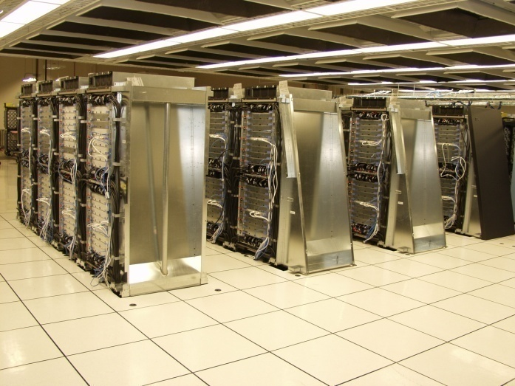
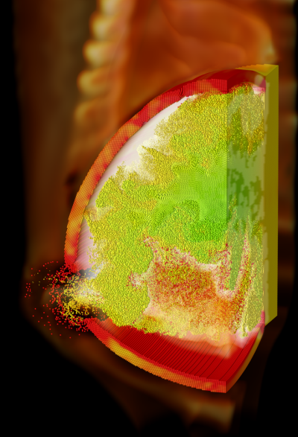
Background
The scientific community is increasingly employing expensive supercomputers that employ distributed programming libraries….
(BlueGene/L - Image courtesy of IBM / LLNL)
…to program large-scale simulations in all walks of science, engineering, math, economics, etc. We want to avoid bugs in MPI programs
(Image courtesy of Steve Parker, CSAFE, Utah)

Slide 56
Main ISP features
Takes a terminating MPI / C program
  MPI programs are pretty much of this kind
  MPI_Finalize must eventually be executed
Employs very limited static analysis
Achieves instrumentation through PMPI trapping
Runs the resulting program under the mercy of our scheduler
  Our scheduler implements OUR OWN dynamic partial order reduction called POE
  Cannot use the Flanagan / Godefroid algorithm for MPI
Finds deadlocks, communication races, assertion violations
Requires NO MODEL BUILDING OR MAINTENANCE!
  simply a push-button verifier
Notes:
A caching hierarchy can be designed either as inclusive, exclusive, and non-inclusive. Referring to our 2-level protocol, “inclusive” means the content of the L1 cache is a subset of the L2 cache. “Exclusive” means that any block that is present in an L1 cache, it cannot be present in the L2 cache in the same cluster. And “non-inclusive” lies between inclusive and exclusive.
In fact, we can take inclusive and exclusive as special cases of non-inclusive protocols. So it can be said that if we can effectively verify non-inclusive protocols, we can actually verify the protocol with any caching policy.

Slide 57
How well does ISP work?

Slide 58
Experiments
ISP was run on 69 examples of the Umpire test suite.
  Detected deadlocks in these examples where tools like Marmot cannot detect these deadlocks.
  Produced far smaller number of interleavings compared to those without reduction.
ISP run on Parmetis ~ 14k lines of code push-button
  Test harness used was Part3KWay
    Widely used for parallel partitioning of large hypergraphs
    GENERATED ONE INTERLEAVING
  ISP run on MADRE
    (Memory aware data redistribution engine by Siegel and Siegel, EuroPVM/MPI 08)
    Found previously KNOWN deadlock, but AUTOMATICALLY within one second ! (in the simplest testing mode of MADRE – but only that had multiple interleavings…)
Results available at:
http://www.cs.utah.edu/formal_verification/ISP_Tests

Slide 59
ISP looks ONLY for “low-hanging” bugs (no LTL, CTL, …)
Three bug classes it looks for are presented next

Slide 60
Deadlock pattern…
P0 P1
--- ---
Bcast; Barrier;
Barrier; Bcast;
P0 P1
--- ---
s(P1); s(P0);
r(P1); r(P0);
2/16/2009
Notes:
Here is a small program snip taken, and modified, from an example in one of Pacheco’s books. We have modified it so it has a deadlock. Can you find it? It’s a simple off by one. We can find it and others like it.
60

Slide 61
Communication Race Pattern…
P0 P1 P2
--- --- ---
r(*); s(P0); s(P0);
r(P1);
OK
P0 P1 P2
--- --- ---
r(*); s(P0); s(P0);
r(P1);
NOK
2/16/2009
Notes:
Here is a small program snip taken, and modified, from an example in one of Pacheco’s books. We have modified it so it has a deadlock. Can you find it? It’s a simple off by one. We can find it and others like it.
61

Slide 62
Resource Leak Pattern…
P0
---
some_allocation_op(&handle);
FORGOTTEN DEALLOC !!
2/16/2009
Notes:
Here is a small program snip taken, and modified, from an example in one of Pacheco’s books. We have modified it so it has a deadlock. Can you find it? It’s a simple off by one. We can find it and others like it.
62

Slide 63
Q: Why does the Flanagan / Godefroid DPOR not suffice for ISP ?
A: MPI semantics are far far trickier
A: MPI progress engine has “a mind of its own”
The “crooked barrier” quiz to follow will tell you why…

Slide 64
Why is even this much debugging hard?
The “crooked barrier” quiz will show you why…
P0
---
MPI_Isend ( P2 )
MPI_Barrier
P1
---
MPI_Barrier
MPI_Isend( P2 )
P2
---
MPI_Irecv ( ANY )
MPI_Barrier
Will P1’s Send Match P2’s Receive ?

Slide 65
MPI Behavior
The “crooked barrier” quiz
P0
---
MPI_Isend ( P2 )
MPI_Barrier
P1
---
MPI_Barrier
MPI_Isend( P2 )
P2
---
MPI_Irecv ( ANY )
MPI_Barrier
It will ! Here is the animation

Slide 66
MPI Behavior
The “crooked barrier” quiz
P0
---
MPI_Isend ( P2 )
MPI_Barrier
P1
---
MPI_Barrier
MPI_Isend( P2 )
P2
---
MPI_Irecv ( ANY )
MPI_Barrier

Slide 67
MPI Behavior
The “crooked barrier” quiz
P0
---
MPI_Isend ( P2 )
MPI_Barrier
P1
---
MPI_Barrier
MPI_Isend( P2 )
P2
---
MPI_Irecv ( ANY )
MPI_Barrier

Slide 68
MPI Behavior
The “crooked barrier” quiz
P0
---
MPI_Isend ( P2 )
MPI_Barrier
P1
---
MPI_Barrier
MPI_Isend( P2 )
P2
---
MPI_Irecv ( ANY )
MPI_Barrier

Slide 69
MPI Behavior
The “crooked barrier” quiz
P0
---
MPI_Isend ( P2 )
MPI_Barrier
P1
---
MPI_Barrier
MPI_Isend( P2 )
P2
---
MPI_Irecv ( ANY )
MPI_Barrier

Slide 70
MPI Behavior
The “crooked barrier” quiz
P0
---
MPI_Isend ( P2 )
MPI_Barrier
P1
---
MPI_Barrier
MPI_Isend( P2 )
P2
---
MPI_Irecv ( ANY )
MPI_Barrier

Slide 71
MPI Behavior
The “crooked barrier” quiz
P0
---
MPI_Isend ( P2 )
MPI_Barrier
P1
---
MPI_Barrier
MPI_Isend( P2 )
P2
---
MPI_Irecv ( ANY )
MPI_Barrier
We need a dynamic verification approach to be aware
of the details of the API behavior…

Slide 72
Reason why DPOR won’t do :
Can’t replay with P1’s send coming first!!
P0
---
MPI_Isend ( P2 )
MPI_Barrier
P1
---
MPI_Barrier
MPI_Isend( P2 )
P2
---
MPI_Irecv ( ANY )
MPI_Barrier
See our CAV 2008 paper for details (also EuroPVM / MPI 2008)

Slide 73
Workflow of ISP
Executable
Proc₁
Proc₂
……
Proc_{n}
MPI Program
Scheduler
Run
Profiler
Manifest only/all relevant
interleavings (DPOR)
MPI Runtime
Manifest ALL relevant
interleavings of the MPI
Progress Engine :
- Done by DYNAMIC
REWRITING of WILDCARD
Receives.

Slide 74
The basic PMPI trick played by ISP

Slide 75
Using PMPI
P0’s Call Stack
Scheduler
User_Function
TCP socket
MPI_Send
P0: MPI_Send
MPI_Send
SendEnvelope
PMPI_Send
PMPI_Send
In MPI Runtime
MPI Runtime

Slide 76
Main idea behind POE
MPI has a pretty interesting out-of-order execution semantics
  We “gleaned” the semantics by studying the MPI reference document, talking to MPI experts, reading the MPICH2 code base, AND using our formal semantics
“Give MPI its own dose of medicine”
  I.e. exploit the OOO semantics
  Delay sending weakly ordered operations into the MPI runtime
  Run a process, COLLECT its operations, DO NOT send it into the MPI runtime
  SEND ONLY WHEN ABSOLUTELY POSITIVELY forced to send an action
  This is the FENCE POINT within each process
This way we are guaranteed to discover the maximal set of sends that can match a wildcard receive !!!
Notes:
A caching hierarchy can be designed either as inclusive, exclusive, and non-inclusive. Referring to our 2-level protocol, “inclusive” means the content of the L1 cache is a subset of the L2 cache. “Exclusive” means that any block that is present in an L1 cache, it cannot be present in the L2 cache in the same cluster. And “non-inclusive” lies between inclusive and exclusive.
In fact, we can take inclusive and exclusive as special cases of non-inclusive protocols. So it can be said that if we can effectively verify non-inclusive protocols, we can actually verify the protocol with any caching policy.

Slide 77
The POE algorithm
POE = Partial Order reduction avoiding Elusive Interleavings

Slide 78
POE
Scheduler
P0 P1 P2
Isend(1)
sendNext
Barrier
Isend(1, req)
Irecv(*, req)
Barrier
Barrier
Barrier
Isend(1, req)
Wait(req)
Recv(2)
Wait(req)
Wait(req)
MPI Runtime

Slide 79
POE
Scheduler
P0 P1 P2
Isend(1)
Barrier
sendNext
Isend(1, req)
Irecv(*, req)
Barrier
Irecv(*)
Barrier
Barrier
Barrier
Isend(1, req)
Wait(req)
Recv(2)
Wait(req)
Wait(req)
MPI Runtime

Slide 80
POE
Scheduler
P0 P1 P2
Isend(1)
Barrier
Barrier
Isend(1, req)
Irecv(*, req)
Barrier
Barrier
Barrier
Irecv(*)
Barrier
Barrier
Isend(1, req)
Barrier
Wait(req)
Recv(2)
Wait(req)
Wait(req)
Barrier
MPI Runtime

Slide 81
POE
Scheduler
P0 P1 P2
Isend(1)
Irecv(2)
Barrier
Isend
Isend(1, req)
Irecv(*, req)
Barrier
Wait (req)
No
Match-Set
Irecv(*)
Barrier
Barrier
Isend(1, req)
Barrier
Recv(2)
SendNext
Wait(req)
Recv(2)
Wait(req)
Wait(req)
Deadlock!
Barrier
Wait
Isend(1)
Wait (req)
MPI Runtime

Slide 82
Once ISP discovers the maximal set of sends that can match a wildcard receive, it employs DYNAMIC REWRITING of wildcard receives into SPECIFIC RECEIVES !!

Slide 83
Discover All Potential Senders by Collecting (but not issuing) operations at runtime…
P0
---
MPI_Isend ( P2 )
MPI_Barrier
P1
---
MPI_Barrier
MPI_Isend( P2 )
P2
---
MPI_Irecv ( ANY )
MPI_Barrier

Slide 84
Rewrite “ANY” to ALL POTENTIAL SENDERS
P0
---
MPI_Isend ( P2 )
MPI_Barrier
P1
---
MPI_Barrier
MPI_Isend( P2 )
P2
---
MPI_Irecv ( P0 )
MPI_Barrier

Slide 85
Rewrite “ANY” to ALL POTENTIAL SENDERS
P0
---
MPI_Isend ( P2 )
MPI_Barrier
P1
---
MPI_Barrier
MPI_Isend( P2 )
P2
---
MPI_Irecv ( P1 )
MPI_Barrier

Slide 86
Recurse over all such configurations !
P0
---
MPI_Isend ( P2 )
MPI_Barrier
P1
---
MPI_Barrier
MPI_Isend( P2 )
P2
---
MPI_Irecv ( P1 )
MPI_Barrier

Slide 87
We’ve learned how to fight the MPICH2 progress engine (and win so far)
May have to re-invent the tricks for OpenMPI
Eventually will build OUR OWN verification version of the MPI library…

Slide 88
MPI_Waitany + POE
P0 P1 P2
Scheduler
sendNext
sendNext
Isend(1, req[0])
Isend(1, req[0])
Recv(0)
Barrier
Isend(2, req[0])
Waitany(2, req)
Isend(2, req[1])
Barrier
Recv(0)
Recv(0)
Waitany(2,req)
Barrier
Barrier
MPI Runtime

Slide 89
MPI_Waitany + POE
P0 P1 P2
Scheduler
Isend(1,req[0])
Isend(1, req[0])
Isend(1, req[0])
Recv(0)
Barrier
Isend(2, req[0])
Waitany(2, req)
Recv
Isend(2, req[1])
Barrier
Recv(0)
Recv(0)
Barrier
Waitany(2,req)
req[0]
Valid
Barrier
Error! req[1] invalid
Barrier
Invalid
req[1]
MPI_REQ_NULL
MPI Runtime

Slide 90
MPI Progress Engine Issues
P0 P1
Scheduler
sendNext
Irecv(1, req)
Scheduler Hangs
Irecv(1, req)
Isend(0, req)
Barrier
Barrier
Wait(req)
sendNext
Wait(req)
Barrier
Isend(0, req)
Does not Return
Wait
PMPI_Wait
PMPI_Irecv + PMPI_Wait
MPI Runtime

Slide 91
We are building a formal semantics for MPI
150 of the 320 API functions specified
Earlier version had a C frontend
The present spec occupies 191 printed pages (11 pt)

Slide 92
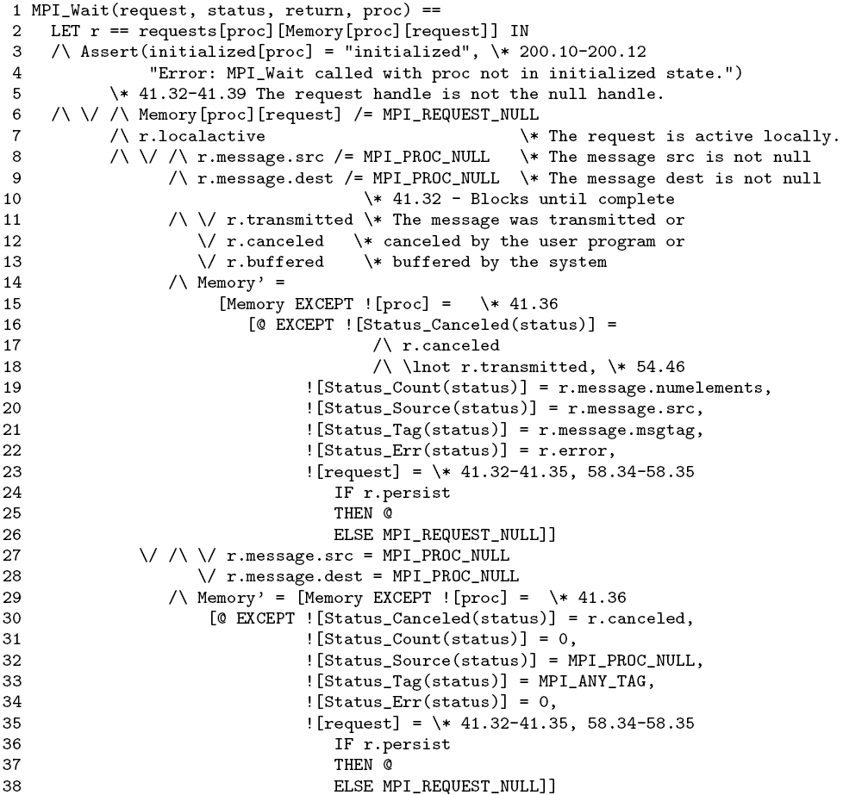
TLA+ Spec of MPI_Wait (Slide 1/2)

Slide 93
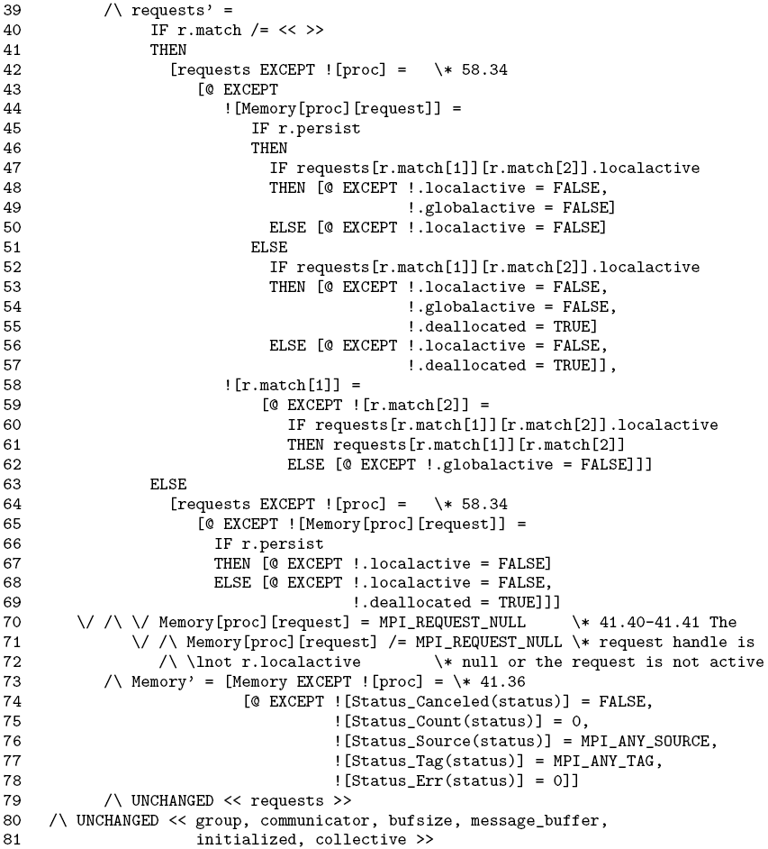
TLA+ Spec of MPI_Wait (Slide 2/2)

Slide 94
Executable Formal Specification can help validate our understanding of MPI …
Visual Studio 2005
Verification Environment
Phoenix Compiler
MPIC IR
TLA+ MPI
Library Model
TLA+ Prog. Model
MPIC Program Model
TLC Model Checker
MPIC Model Checker
FMICS 07
PADTAD 07
2/16/2009

Slide 95
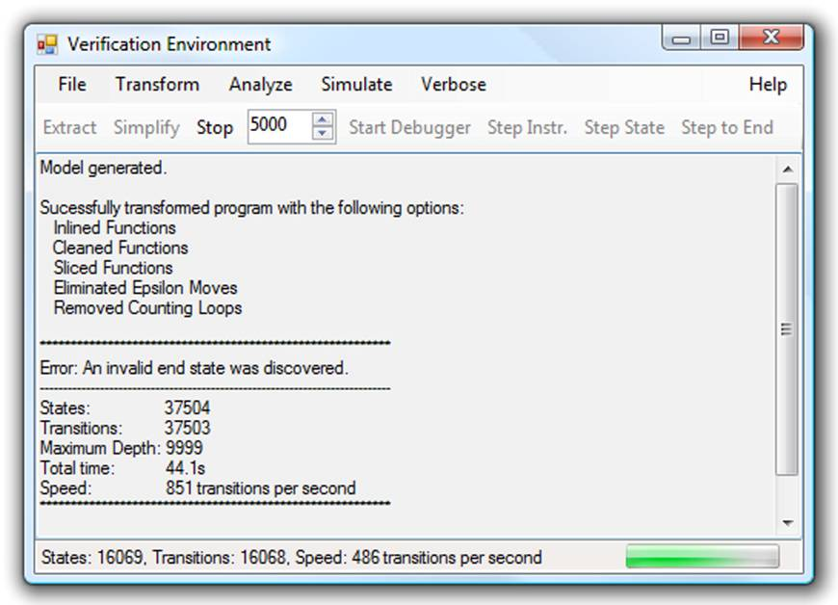
The Histrionics of FV for HPC (1)
Notes:
Subject the system (or a reduced version of the system) to a collection of inputs (and hence execution paths)
Concrete example: when codes are ported, they typically break

Slide 96
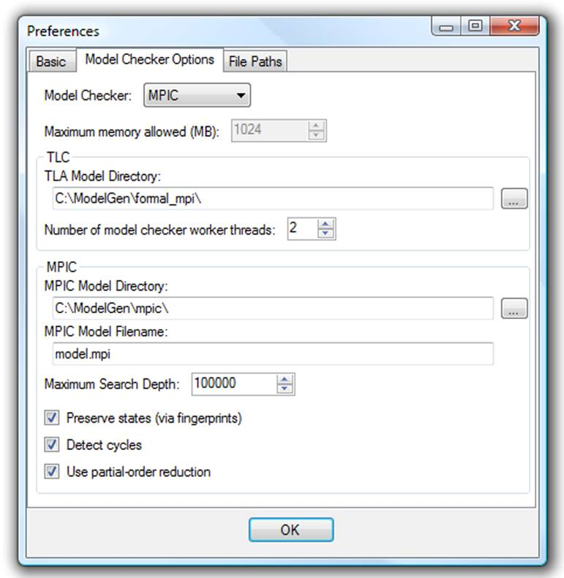
The Histrionics of FV for HPC (2)
Notes:
Subject the system (or a reduced version of the system) to a collection of inputs (and hence execution paths)
Concrete example: when codes are ported, they typically break

Slide 97
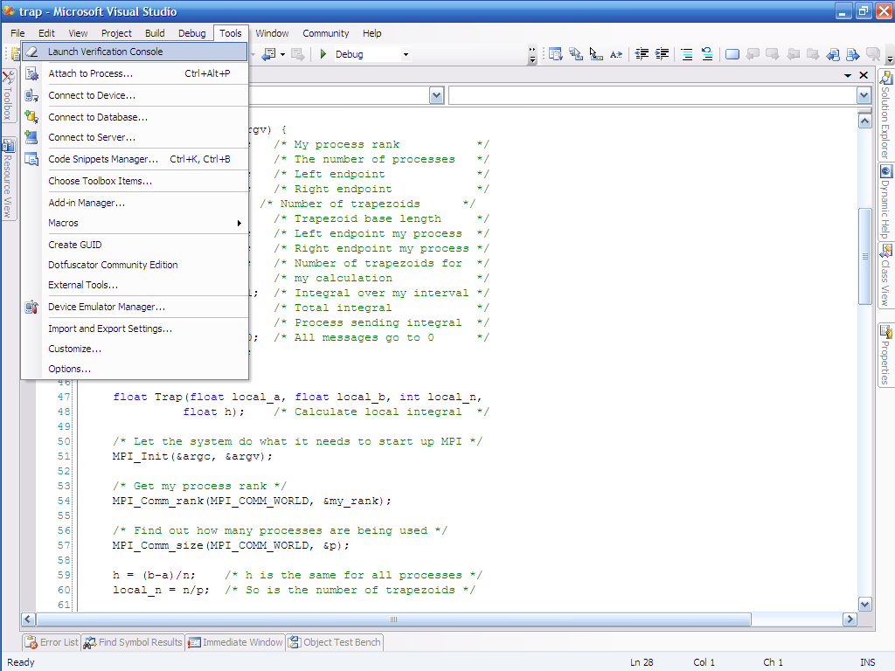
Error-trace Visualization in VisualStudio

Slide 98
What does FIB do ?
FIB rides on top of ISP
It helps determine which MPI barriers are Functionally Irrelevant !
Notes:
A caching hierarchy can be designed either as inclusive, exclusive, and non-inclusive. Referring to our 2-level protocol, “inclusive” means the content of the L1 cache is a subset of the L2 cache. “Exclusive” means that any block that is present in an L1 cache, it cannot be present in the L2 cache in the same cluster. And “non-inclusive” lies between inclusive and exclusive.
In fact, we can take inclusive and exclusive as special cases of non-inclusive protocols. So it can be said that if we can effectively verify non-inclusive protocols, we can actually verify the protocol with any caching policy.

Slide 99
Fib Overview – is this barrier relevant ?
P0
---
MPI_Irecv(*, &req);
MPI_Wait(&req);
MPI_Barrier();
MPI_Finalize();
P1
---
MPI_Isend(to 0, 33);
MPI_Barrier();
MPI_Finalize();
P2
---
MPI_Barrier();
MPI_Isend(to P0, 22);
MPI_Finalize();

Slide 100
Fib Overview – is this barrier relevant ?
Yes! But if you move Wait after Barrier, then NO!
P0
---
MPI_Irecv(*, &req);
MPI_Wait(&req);
MPI_Barrier();
MPI_Finalize();
P1
---
MPI_Isend(to 0, 33);
MPI_Barrier();
MPI_Finalize();
P2
---
MPI_Barrier();
MPI_Isend(to P0, 22);
MPI_Finalize();

Slide 101
IntraCB Edges (how much program order maintained in executions)
P0
---
MPI_Irecv(*, &req);
MPI_Wait(&req);
MPI_Barrier();
MPI_Finalize();
P1
---
MPI_Isend(to 0, 33);
MPI_Barrier();
MPI_Finalize();
P2
---
MPI_Barrier();
MPI_Isend(to P0, 22);
MPI_Finalize();

Slide 102
IntraCB (implied transitivity)
P0
---
MPI_Irecv(*, &req);
MPI_Wait(&req);
MPI_Barrier();
MPI_Finalize();
P1
---
MPI_Isend(to 0, 33);
MPI_Barrier();
MPI_Finalize();
P2
---
MPI_Barrier();
MPI_Isend(to P0, 22);
MPI_Finalize();

Slide 103
InterCB introduction: for any x,y in a match set, add InterCB from x to every IntraCB successor of y
P0
---
MPI_Irecv(*, &req);
MPI_Wait(&req);
MPI_Barrier();
MPI_Finalize();
P1
---
MPI_Isend(to 0, 33);
MPI_Barrier();
MPI_Finalize();
P2
---
MPI_Barrier();
MPI_Isend(to P0, 22);
MPI_Finalize();

Slide 104
InterCB introduction: for any x,y in a match set, add InterCB from x to every IntraCB successor of y
Match set formed
during POE
P0
---
MPI_Irecv(from 1, &req);
MPI_Wait(&req);
MPI_Barrier();
MPI_Finalize();
P1
---
MPI_Isend(to 0, 33);
MPI_Barrier();
MPI_Finalize();
P2
---
MPI_Barrier();
MPI_Isend(to P0, 22);
MPI_Finalize();

Slide 105
InterCB introduction: for any x,y in a match set, add InterCB from x to every IntraCB successor of y
Match set formed
during POE
P0
---
MPI_Irecv(from 1, &req);
MPI_Wait(&req);
MPI_Barrier();
MPI_Finalize();
P1
---
MPI_Isend(to 0, 33);
MPI_Barrier();
MPI_Finalize();
P2
---
MPI_Barrier();
MPI_Isend(to P0, 22);
MPI_Finalize();
InterCB

Slide 106
InterCB introduction: for any x,y in a match set, add InterCB from x to every IntraCB successor of y
P0
---
MPI_Irecv(from 1, &req);
MPI_Wait(&req);
MPI_Barrier();
MPI_Finalize();
P1
---
MPI_Isend(to 0, 33);
MPI_Barrier();
MPI_Finalize();
P2
---
MPI_Barrier();
MPI_Isend(to P0, 22);
MPI_Finalize();
InterCB

Slide 107
InterCB introduction: for any x,y in a match set, add InterCB from x to every IntraCB successor of y
P0
---
MPI_Irecv(from 1, &req);
MPI_Wait(&req);
MPI_Barrier();
MPI_Finalize();
P1
---
MPI_Isend(to 0, 33);
MPI_Barrier();
MPI_Finalize();
P2
---
MPI_Barrier();
MPI_Isend(to P0, 22);
MPI_Finalize();
InterCB
InterCB

Slide 108
Continue adding InterCB as the execution advances
Here, we pick the Barriers to be the match set next…
P0
---
MPI_Irecv(from 1, &req);
MPI_Wait(&req);
MPI_Barrier();
MPI_Finalize();
P1
---
MPI_Isend(to 0, 33);
MPI_Barrier();
MPI_Finalize();
P2
---
MPI_Barrier();
MPI_Isend(to P0, 22);
MPI_Finalize();
InterCB
InterCB

Slide 109
Continue adding InterCB as the execution advances
Here, we pick the Barriers to be the match set next…
P0
---
MPI_Irecv(from 1, &req);
MPI_Wait(&req);
MPI_Barrier();
MPI_Finalize();
P1
---
MPI_Isend(to 0, 33);
MPI_Barrier();
MPI_Finalize();
P2
---
MPI_Barrier();
MPI_Isend(to P0, 22);
MPI_Finalize();
InterCB
InterCB

Slide 110
… newly added InterCBs (only some of them shown…)
P0
---
MPI_Irecv(from 1, &req);
MPI_Wait(&req);
MPI_Barrier();
MPI_Finalize();
P1
---
MPI_Isend(to 0, 33);
MPI_Barrier();
MPI_Finalize();
P2
---
MPI_Barrier();
MPI_Isend(to P0, 22);
MPI_Finalize();
InterCB
InterCB
InterCB
InterCB

Slide 111
Now the question pertains to what was a wild-card receive and a potential sender that could have matched…
P0
---
MPI_Irecv(was *, &req);
MPI_Wait(&req);
MPI_Barrier();
MPI_Finalize();
P1
---
MPI_Isend(to 0, 33);
MPI_Barrier();
MPI_Finalize();
P2
---
MPI_Barrier();
MPI_Isend(to P0, 22);
MPI_Finalize();
InterCB
InterCB
InterCB
InterCB

Slide 112
If they are ordered by a Barrier and NO OTHER OPERATION, then the Barrier is RELEVANT…
P0
---
MPI_Irecv(was *, &req);
MPI_Wait(&req);
MPI_Barrier();
MPI_Finalize();
P1
---
MPI_Isend(to 0, 33);
MPI_Barrier();
MPI_Finalize();
P2
---
MPI_Barrier();
MPI_Isend(to P0, 22);
MPI_Finalize();
InterCB
InterCB
InterCB
InterCB

Slide 113
If they are ordered by a Barrier and NO OTHER OPERATION, then the Barrier is RELEVANT…
P0
---
MPI_Irecv(was *, &req);
MPI_Wait(&req);
MPI_Barrier();
MPI_Finalize();
P1
---
MPI_Isend(to 0, 33);
MPI_Barrier();
MPI_Finalize();
P2
---
MPI_Barrier();
MPI_Isend(to P0, 22);
MPI_Finalize();
InterCB
InterCB
InterCB
InterCB

Slide 114
If they are ordered by a Barrier and NO OTHER OPERATION, then the Barrier is RELEVANT…
P0
---
MPI_Irecv(was *, &req);
MPI_Wait(&req);
MPI_Barrier();
MPI_Finalize();
P1
---
MPI_Isend(to 0, 33);
MPI_Barrier();
MPI_Finalize();
P2
---
MPI_Barrier();
MPI_Isend(to P0, 22);
MPI_Finalize();
InterCB
InterCB
InterCB
InterCB

Slide 115
If they are ordered by a Barrier and NO OTHER OPERATION, then the Barrier is RELEVANT…
P0
---
MPI_Irecv(was *, &req);
MPI_Wait(&req);
MPI_Barrier();
MPI_Finalize();
P1
---
MPI_Isend(to 0, 33);
MPI_Barrier();
MPI_Finalize();
P2
---
MPI_Barrier();
MPI_Isend(to P0, 22);
MPI_Finalize();
InterCB
InterCB
InterCB
InterCB

Slide 116
In this example, the Barrier is relevant !!
P0
---
MPI_Irecv(was *, &req);
MPI_Wait(&req);
MPI_Barrier();
MPI_Finalize();
P1
---
MPI_Isend(to 0, 33);
MPI_Barrier();
MPI_Finalize();
P2
---
MPI_Barrier();
MPI_Isend(to P0, 22);
MPI_Finalize();
InterCB
InterCB
InterCB
InterCB

Slide 117
Concluding Remarks
We think that Dynamic Verification with a suitable DPOR algorithm has MANY merits
It is SO under-researched that we strongly encourage others to join this brave group
This may lead to tools that practitioners can IMMEDIATELY employ without any worry of model building or maintenance
Notes:
A caching hierarchy can be designed either as inclusive, exclusive, and non-inclusive. Referring to our 2-level protocol, “inclusive” means the content of the L1 cache is a subset of the L2 cache. “Exclusive” means that any block that is present in an L1 cache, it cannot be present in the L2 cache in the same cluster. And “non-inclusive” lies between inclusive and exclusive.
In fact, we can take inclusive and exclusive as special cases of non-inclusive protocols. So it can be said that if we can effectively verify non-inclusive protocols, we can actually verify the protocol with any caching policy.

Slide 118
Demo Inspect, ISP, and FIB
(and MPEC if you wish…)

Slide 119

Looking Further Ahead: Need to clear “idea log-jam in multi-core computing…”
“There isn’t such a thing as Republican clean air or Democratic clean air. We all breathe the same air.”
There isn’t such a thing as an architectural-only solution, or a compilers-only solution to future problems in multi-core computing…

Slide 120
Now you see it; Now you don’t !
On the menace of non reproducible bugs.
Bob's.ppt
http://www.geocities.com/bkip20002/index.html
Graphics by Bob
http://home.att.net/~kip20002/
Deterministic replay must ideally be an option
User programmable schedulers greatly emphasized by expert developers
Runtime model-checking methods with state-space reduction holds promise in meshing with current practice…

