Slide 1
The Art of Interface Design
Anne Morgan Spalter | Rich Riesenfeld
Brown University | University of Utah
CS6540/5540 HCI
Fall 2009

Slide 2
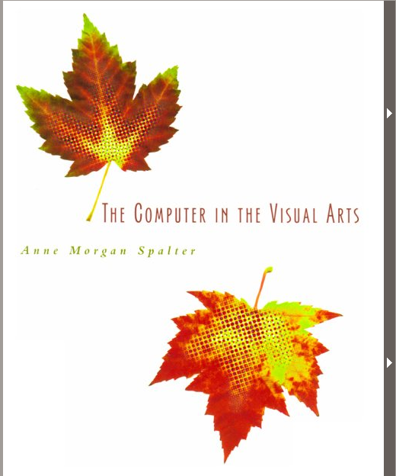
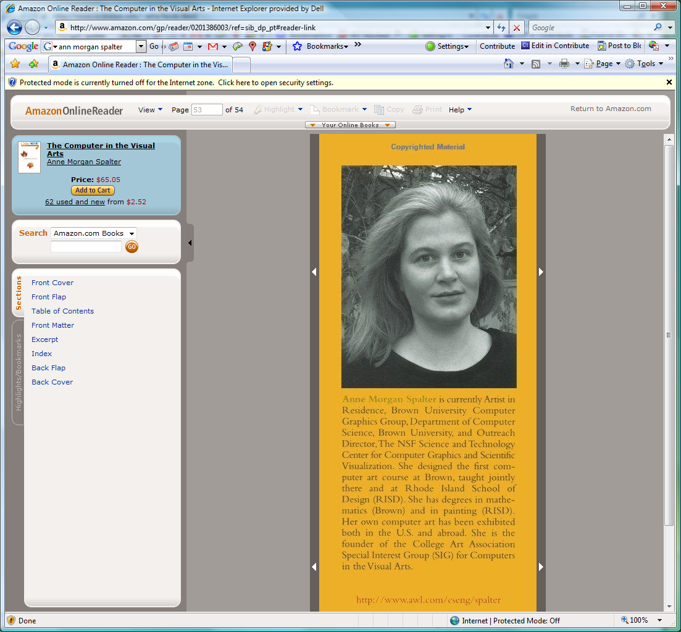
Anne Morgan Spalter

Slide 3
Inter-related Components of Interface Design
Task analysis and user testing
Software engineering
Functional analysis
Aesthetic appeal
Etc.

Slide 4
Looking Good—Then & Now - 1
Some issues same as traditional design
  Overall composition (leading the eye, creating balance, etc.)
  Use of shape/form
    Affordance: buttons, sliders, levers, arrows, etc
  Use of color (not having too many different colors, using color to code features, etc.)

Slide 5
Looking Good—Then & Now - 2
Graphic Arts and Design
  People study years to learn this formally
  There are many full-time jobs performing just this function
  Characteristics
    Challenging task
    Important factor for success of project
    Takes significant project time to do well

Slide 6
Looking Good—Then & Now - 3
Some issues unique to digital media
  Interaction
    Principles not fully established yet
  Animation
    Content may change over time
    Motion is tricky
  Integration of different (multi-) media
    E.g., text, image, sound elements
    Gives rise to more complex design issues
Notes:
[I can also give examples of these with more of a visual emphasis than Shneiderman has] - ams

Slide 7
Looking Good—Then & Now - 4
Issues unique to digital media (cont)
  Need to structure much information, e.g.
    Design hierarchy
    Navigation aids
  Ever-changing tools, usage platforms
    Including new immersive spaces
Notes:
[I can also give examples of these with more of a visual emphasis than Shneiderman has] - ams

Slide 8
Some Traditional Design | -1
Concerns in Digital Media
These and other issues present new aesthetic design challenges
Aligning elements
Grouping elements appropriately for dialog boxes or screen design
Designing clear, associative icons

Slide 9
Some Traditional Design Concerns in Digital Media 2
Using type of screen
Use of color
  Do not over-use it
  Consistent, thematic use
  Tasteful, aesthetic balance
  Appropriate to target audience
    Business/professional group
    Young children, etc …

Slide 10
Some Traditional Design Concerns in Digital Media 3
Appropriate and consistent style
Traditional design strategies, e.g., using
  small multiples
  layering
  narrative
  metaphor
Notes:
[are these the type of things you’re most interested in communicating? I can give lots of example, but each could also be a whole course in and of itself. At RISD designers take a full year of typography, for instance.]

Slide 11
Some Traditional Design Concerns in Digital Media 4
Clean designs
  Reducing clutter and visual noise
At RISD designers take a full year of typography, e.g.
  Stuff is not trivial
  Painfully bad designs by unskilled purveyors abound!
Notes:
[are these the type of things you’re most interested in communicating? I can give lots of example, but each could also be a whole course in and of itself. At RISD designers take a full year of typography, for instance.]

Slide 12
Colors, Fonts, Elements - 1
Contrasting colors, use primaries and complements
Design a sensible look, a scheme, a design, that is appropriate to the task
  Children, how would you do this
  Physicians, how would this look
Uncluttered, coherent, structured

Slide 13
Colors, Fonts, Elements - 2
Use hierarchy, urls, top-down expansions, hypertext, etc
Fonts
  Clean, no serifs
  Drop shadowed can give some relief, 3D effect gives life
Good composition
  Symmetry gets tedious
  Make presentation interesting

Slide 14
Colors, Fonts, Elements - 3
Avoid “cheap licks,” for professional, serious interfaces
  Spins, fly-ins, etc
  Noise effects gets distracting, annoying
All of these devices should be considered like spices
  Highly effective when used sparingly and appropriately
  Who wants to read a style with a “!” at the end of each sentence.

Slide 15
An Example 1
An Example | -1
I asked a student to recreate some of our java color applets in Director (as shockwave files), and
  Told him to make them look the same as the original ones
He decided to add a bit of his own design to them
  Results were very disappointing

Slide 16
An Example 2
An Example | -2
It’s interesting because
  Functionality is exactly the same
  Change in only in aesthetics
  Much less pleasurable to use new the applets
    (Student flunks out…)

Slide 17
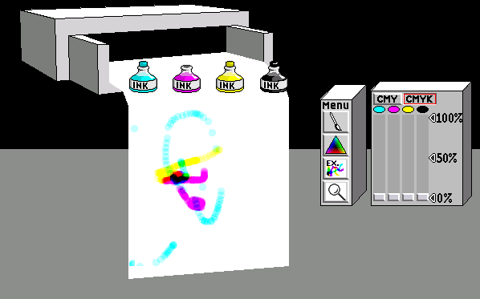
Older, Java version
Not perfect but
  Nice feeling
  Important because the concept being taught is pretty simple

Slide 18
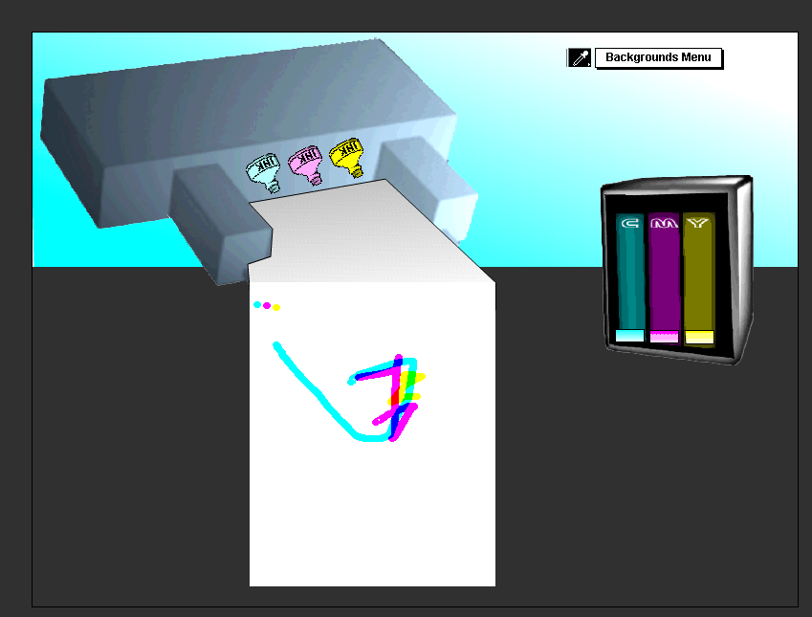
Revised (Student) Version

Slide 19
Two Up Comparison
Original
Revised

Slide 20
What Changed? 1
What Changed? | 1
Important aesthetic differences
  Variations subtle
  Change pleasure of using applet
New version too big
  Poor use of screen real estate
  Program hogs up too much screen
Notes:
subtle but important aesthetic differences change pleasure of using applet. New version is too big—bad use of screen real estate causes the program to hog up a lot of the screen, has unpleasant and totally irrelevant background color (greenish) behind printer, also has too much black—not nice use of gray in the older version. Printer doesn’t look realistic or diagrammatic—just like a bad 3D model, ink bottles not properly anti-aliased, many problem with perspective: ink bottle position, printer position, paper position, and “case” for sliders. The gradient banding is annoying, the sliders look like binders not sliders and application of gradient makes the colors too black, unattractive font for CMY letters on sliders. Different treatment of slider case and printer—inconsistent style is distracting. Use of black outline on paper makes it separate from printer and seem to be floating above it

Slide 21
Two Up Comparison
Original
Revised

Slide 22
What Changed? 2
What Changed? | 2
Color use
  greenish background color behind printer
  Unpleasant, distracting background
  Totally irrelevant color choice
Also, too much black
  Lost nice use of gray in the original

Slide 23
Two Up Comparison
Original
Revised

Slide 24
What Changed? 3
What Changed? | 3
Printer doesn’t look realistic or diagrammatic—
  just like a bad 3D model,
Ink bottles not properly anti-aliased

Slide 25
Two Up Comparison
Original
Revised

Slide 26
What Changed? 4
What Changed? | 4
Many problems with perspective
  Ink bottle position
  Printer position
  paper position
  “Case” for sliders
Gradient banding is annoying

Slide 27
Two Up Comparison
Original
Revised

Slide 28
What Changed? 5
What Changed? | 5
Sliders
  Look like binders not sliders
  Application of gradient makes the colors too black
  Unattractive font for CMY letters
  Different treatment of slider case and printer
    inconsistent style is distracting
Undesirable effects of black outline on paper
  Makes it separate from printer
  Seems to be floating above it

Slide 29
Two Up Comparison
Original
Revised

Slide 30
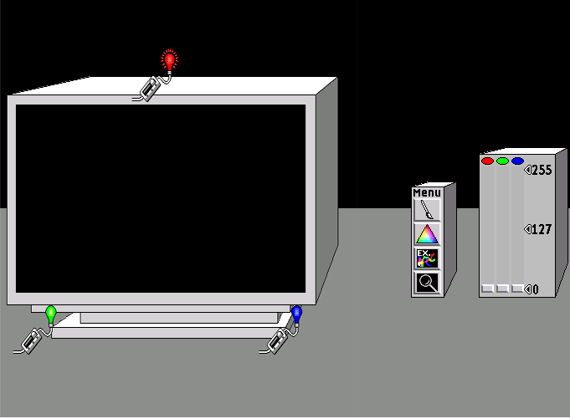
And Another New Version 1
And Another New Version | 1

Slide 31
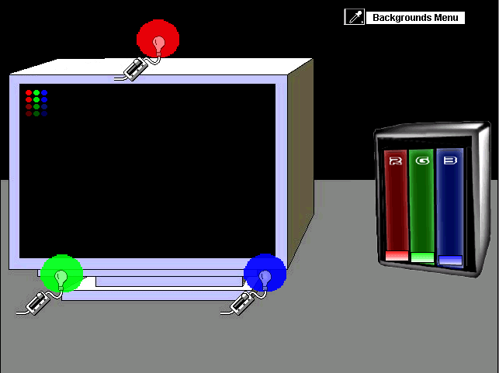
And Another New Version 2
And Another New Version | 2

Slide 32
What’s Wrong? 1
What’s Wrong? | 1
This one looked better because
  Used more of the original design
  Original was a nice one,
Now his two applets don’t look alike,
  Bad choice for a series of related applets
  Violates consistency

Slide 33
What’s Wrong? 2
What’s Wrong? | 2
Lights are lit up differently
  Subtle but makes a big difference
Purple around the edge of the monitor
  Bad choice since it’s a color apple
  Contrasting color affects color perception
  Alters how we see the subject matter

Slide 34
And Another New Version 1
And Another New Version | 1

Slide 35
And Another New Version 2
And Another New Version | 2

Slide 36
Principle of 3 in Arts
3 is Ubiquitous in Arts
Std play has 3 acts
Musical composition
  Variations of ABC format
  A,B,C are major elements
    Theme
    Development
    Recapitulation

Slide 37
Principle of 3 in Arts
Western Music widely uses 3 chord progression
  IV, V, I
  II, V, I

Slide 38
Principle of 3 in Arts
Photography
  Foreground
    may use depth of field to de-emphasize (blur)
  Subject
    must be in focus)
  Background (may use depth of field)

Slide 39
Principle of 3 in Arts
Portrait Art
  Human face divided into 3 parts
    Eyes and above
    Eves to mouth
    Mouth and below

Slide 40
Principle of 3 in Arts
Golden Ratio in Architecture
Golden Triangle
  In religiously inspirit art corners of triangle often express Holy Trinity
    Father, Son, Holy Ghost
  Ex: Mona Lisa

Slide 41
Principle of 3
Public speaking: 3 parts of a speech
  Tell them what you are going to say
  Tell them what you want to say
  Tell them what you have said

Slide 42
Principle of 3 in Arts
See notes section for email text
Notes:
HCIers -
There have been a questions concerning the scope of Assignment #5. Yes, the assignment is rather "open-ended," partly because I wanted to explore the problem in rather broader terms. I realize that this could assignment could be expanded to fulfill the requirements of a thesis, so the issue arises of what is "really wanted." It just occurred to me today that a reasonable guideline might be to suggest that it should reflect a comparable amount of work relative to previous assignments. That is to say, doing a satisfactory job should be attainable is a similar amount of time, maybe a bit more because it is more involved.
However, the assignment is broad enough so that it should present a rich array of challenges for students who are particularly interested in HCI and would like to engage more deeply. There are many directions to explore if one is motivated.
More specifically, on part 1, I can say the following. Give a kind of "product review" for the pros and cons of the main university website, so try to cover some basic set of characteristics against which you will evaluate its performance. My list is just a suggested list so that you are not stuck w/o thoughts. Feel free to consider the website with respect to a different list, or part of the list and some of your added characteristics. It will be more interesting and valuable if you manage to explore it from a somewhat individual perspective. For example, if you are not from Utah or the US, it would be valuable to see your comments on how well the site performs relative to those particular needs and requirements. If you work for the campus radio or TV station, maybe that will give you a personally interesting angle for considering (and improving it).
On part 2, I would like to be sure you at least visit each site in the table and react to it in some fashion. Assessing the sites' degree or influence by what I have called the "principle of three," insures that you examine each site at the highest level. Recall that I talked of the important of "3" in many areas of art and communications. For example, the "standard play" is written in a 3 Act format, musical compositional structures are frequently described in the form of ABA, or ABC where A,B and C are the major thematic elements. Traditional musical form talks of 1) a statement of a theme, 2) its development and 3) its recapitulation. Even the 4 common movements of a symphony piece can be viewed as a slight expansion and variation of this basic notion. The fundamental and persuasive harmonic structure of most Western musical themes is built essentially on "3 chord progression," namely the I, IV and V chords. There are more popular Western tunes that use basically 3 chords than any other structure, regardless of genre. This is eminently clear for folk and Western tunes, including some of the most classic and popular. More complicated progressions often be seen as variations or elaborations of this, so even when there are more than 3 chords present in a piece, the additional chords may simply be "substitution chord" introduced for richness and color, but they are actually performing the traditional function of one of the fundamental 3 chords. As a trivial example, many common jazz tunes use a I, II, V set of chords, but here the II chord is providing a function similar to a IV chord, so we can still talk of this as being a I, IV, V structure.
In art we also often see "three" as an important design concept. For example, when rendering the human face, the form is standardly divided into 3 with the top third being from the eyes above, the middle third from above the mouth, say to the eyes, and the remaining is the bottom third. Those three areas are often defined with sketching so that the three part structure is established in proper position and ration. In photography we often talk of the i) foreground, ii) the subject range, and, iii) the background compositional elements of a scene, where "depth of field" is often used to delineate the regions. There are "golden ratios" that transcend art and architecture from earliest times to provide the most pleasing relationships or forms. And thematically, a great deal of (particularly classical) Western art through many centuries uses triangles where the corners are related to themes. This is particularly the case for religiously inspired or sponsored art, that involves a triangular relationship, the corners showing iconic references, albeit often rather vague or highly stylized, to the Trinity, namely, i) The Father, ii) the Son, and iii) the Holy Ghost. While not always immediately obvious, this relationship pervasively appears in many great paintings. As you may have encountered, themes of 3 are often identified in the Mona Lisa.
A common guideline for public speaking is to divide the talk into 3 parts, and i) tell the audience what you intend to say, ii) say it, and iii) remind the audience what you just told them. Good public speeches usually remain pretty close to this structure. Many, many standard (series) TV shows are built on an evident, highly predictable, 3-part structure. "Law and Order" invariably confronts the audience with a murder scene nearly in the opening shot, and the conclusion is heralded in it score with nearly clockwork, formulaic precision. (I think this is L&W, isn't it??)
Now, we come to web interfaces, where 3-part designs are probably the most common. Truly ubiquitous, we often see them with a major panel and then two lessor panels. If the most basic invocation of this form, the major panel is centrally positioned, and the elements with much narrower width are to the left and right, although the panels often have full screen height. The most basic web widgets, like a pull-down menu, say, work easily in the format. In other words, it is quite common to see the screen space divided into three vertical bands, one dominant wider one, and two narrower ones, but all three being full screen height. There are variations on variations of this basic structure, however some good websites avoid the (hackneyed) 3-part design structure. It is probably somewhat harder to be original and violate the standard 3-element design principle, but one can find such examples. More often, however, a poorly functioning website will have abandoned this classic form, and then failed to display the sensibilities necessary to pull off the individuality of the design. I am merely asking you to pay attention by looking for the presence or absence of this design principle. Make sure that you DO visit each site in the table, however briefly that turns out to be. I chose each one because it was interesting in some particular aspect.
After floating the assignment, I realized that UC Berkeley has a site that I find somewhat more functional and attractive than many other (lacking) university websites: <www.berkeley.edu>. See if you agree. These reactions tend to be rather personal and idiosyncratic, but among all the variation in response I think there are principals to extract about what works and what does not.
I hope this helps. Clearly this note contains the core of a set of lecture notes on the "Principle of Three," but that will go into next years preparation.
Good luck! I hope that this is useful, and that you find some pleasure in carrying out this assignment. This assignment is an entirely new idea, so I will welcome you comments, favorable or otherwise, on its utility in the course and its pedagogical value. Email me, or notate the assignment, if you prefer.

Slide 43
TV Shows
Law and Order
  Formulaic 3 part format
  Usually opens with a crime scene, or very soon after opening
  Story develops
  Conclusion
    Heralded with theme music

Slide 44
Principle of 3 in Web Design
Most common portal has 3 panels
  Panels are often full height, partial width
  Main panel is often in center and wider
  Lesser panels are left and right
  Works well in many situations
  Not too exciting for layout
Many good webpages do not use 3 parts

Slide 45
Conclusions

Slide 46
Everything Must Work Together 1
If you do not understand the client’s needs, it doesn’t matter how beautiful the interface looks.
An aesthetically good interface must work with good overall design
UI work often done in teams with programmers, cognitive scientists, artistic designers, and business people

Slide 47
Everything Must Work Together 2
Design the aesthetics, like everything else in the interface
Give aethestics time and thought
Be tasteful in design
Seek compatible help on aesthetics, if not your strength

Slide 48
Resources
Information Design: Edward Tufte’s book
Multimedia Design: Designing Visual Interface (Mullet/Sano), Design Multimedia (Lopuck)
Web Design: Lisa Weinman’s and David Siegel’s books

Slide 49
Resources
Magazines: Print, How To (these are graphic design magazines that now address many digital design issues)
Information Visualization (Ware) [some “science of graphic design”]

Slide 50
The End
UI Aesthetics

